Slide 1
App Development: Tasker App By: Audrey Thomas
Class CSC3317
Section 2904

Slide 2
Problem to Solve
Make the Lives of those who live together easier and relieve the discord caused by mismatched schedules, exacerbated by the absence of an efficient task management system.

Slide 3
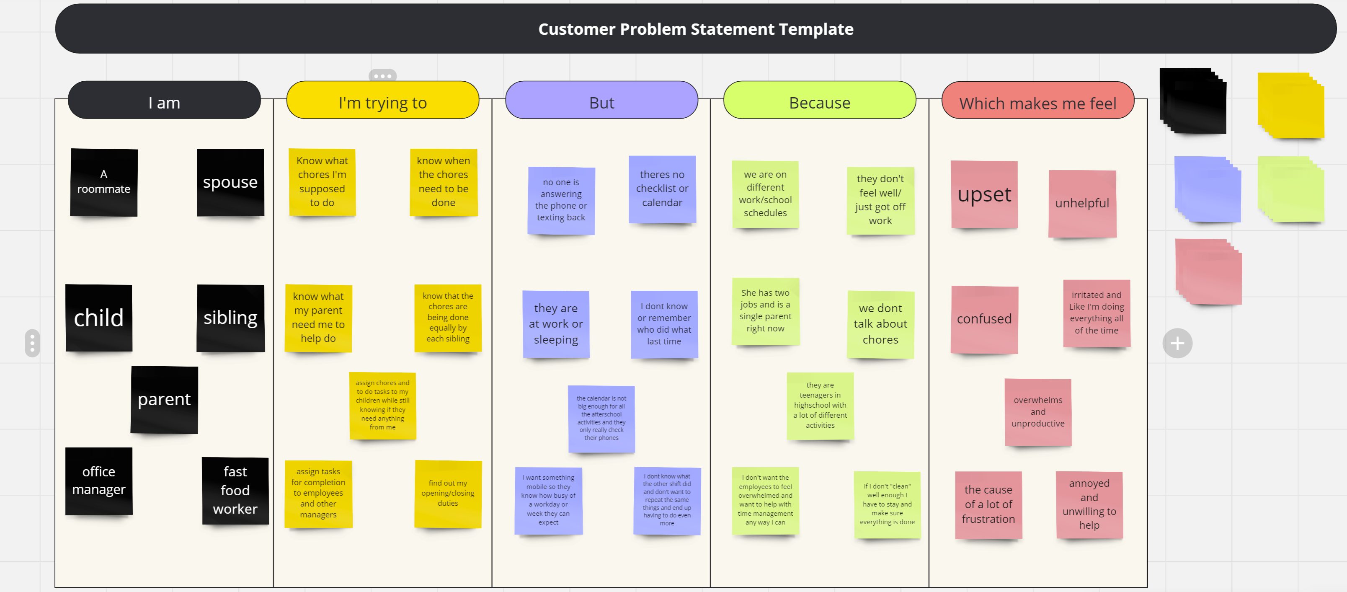
Requirement Gathering
When trying to gather information about this problem, I tried to think of the different scenarios I’ve been in. I also asked others about their feeling and if they had similar situations.

Slide 5
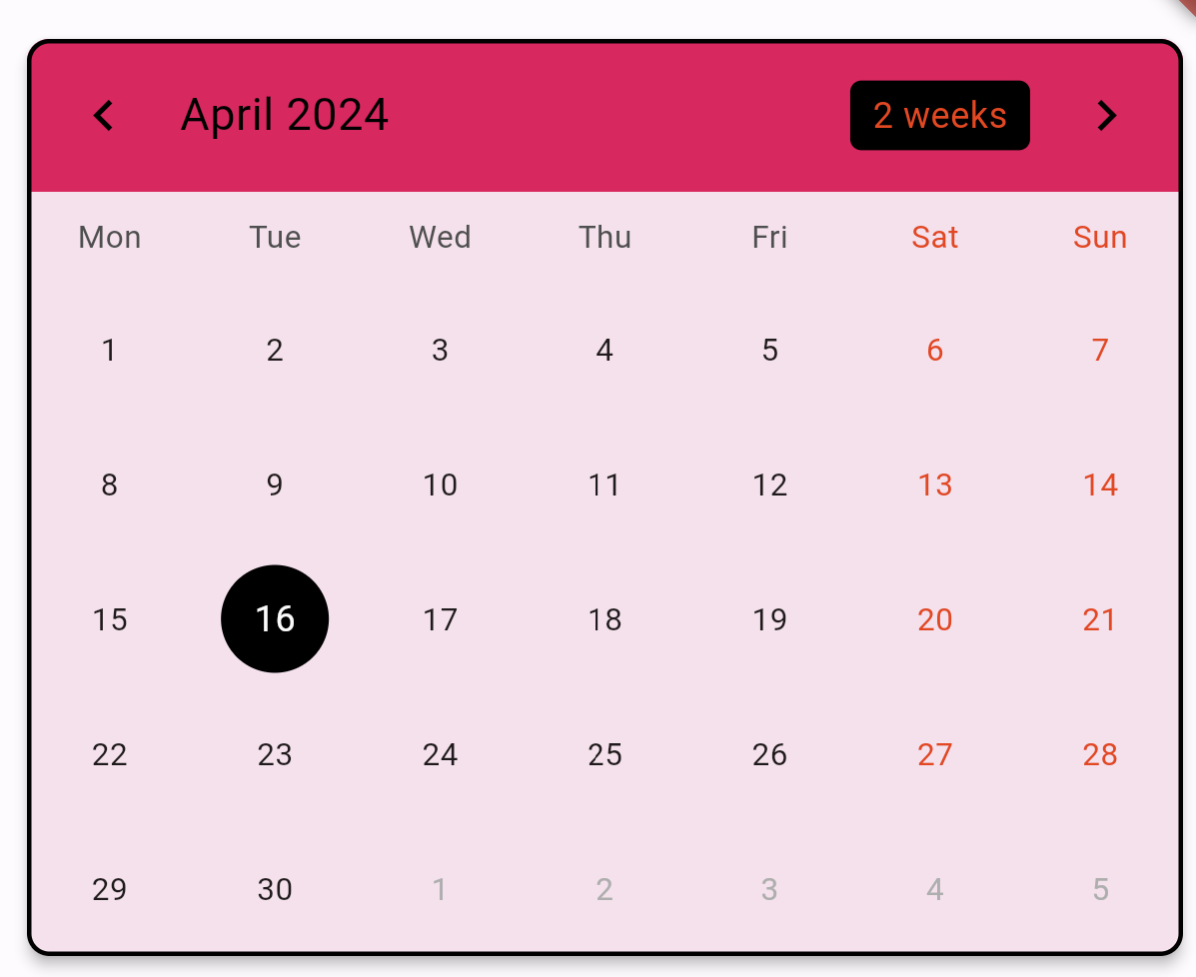
Proposed Solution Create an app that allows you to Join others and create events on a shared calendar.

Slide 6
The Solution
Create an App that
Has a calendar
Directly edit events
Displays all current events*
Has a group function
User can create group*
User can join group*
Can leave group*
Allows the user to add events
Directly in the app
Through email calendar apps*
Create an App that
Has a calendar
table_calendar
a floating action button
Has a group function
Navigation to create/join group
Allows the user to add events
Forum to do more in depth events

Slide 7
Overcoming Issues
Difficulties Learning Flutter and making the code cooperate

Slide 8
Some of the Issues Faced
First Time using flutter and a google based language.
Having experience with other languages helped to navigate Flutter and Dart
Issues getting navigation to work in the app
Not realizing something super simple was causing everything to crash and burn
Figuring out how to find what I didn’t know
Its hard to know what you don’t know
Getting help from Youtube, Stack Overflow, and Various coding blogs
Time constraints
Some features were left on the back burner to get the app functioning
Resource restraints
Not being able to fully make certain aspects work because of a need for more resources

Slide 9
Future Development
Getting the Forum to connect to the calendar
Figuring out how to have others be in a group
Have login connect to google and allow for creation of an account
Most of these functions require some sort of database connection.
They either took too much time resource or storage resource to get working
Some I just didn’t have to knowledge to finish or find out what I needed to finish

Slide 10
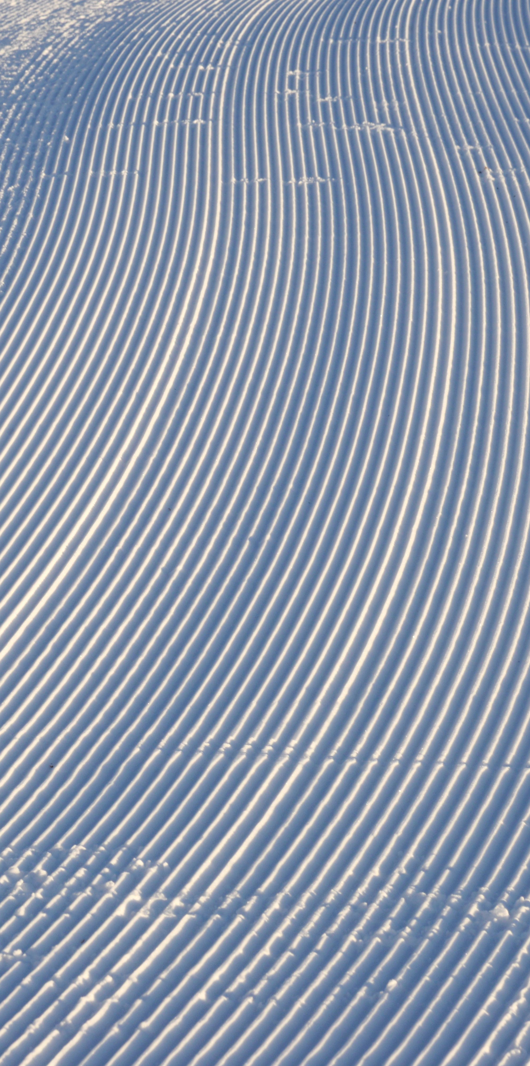
Future Works
In the future I’d love to make game or see more into what the process is to making mobile games.
I also hope to continue to work on the app I started in this class so that I can track my progress

Slide 11
Thank you
Audrey Thomas

